Slide 1
The Maximum Traveling Salesman Problem under Polyhedral Norms
Alexander Barvinok, David S. Johnson, Gerhard J. Woeginger and Russell Woodroffe
Integer Programming and Combinatorial Optimization, 1412 (1998) 195-201
Presenter: Yung-Hsing Peng
Date: 2005.05.24

Slide 2
Abstract
We consider the traveling salesman problem when the cities
are points in R^{d} for some fixed d and distances are computed according to a polyhedral norm. We show that for any such norm, the problem of finding a tour of maximum length can be solved in polynomial time. If arithmetic operations are assumed to take unit time, our algorithms run in time O(n^{f-2}logn), where f is the number of facets of the polyhedron determining the polyhedral norm. Thus for example we have O(n²logn) algorithms for the cases of points in the plane under the Rectilinear and Sup norms. This is in contrast to the fact that finding a minimum length tour in each case is NP-hard.

Slide 3
Main Idea
Max Tunneling TSP can be solved in O(n^{2k-2}logn), where k is the number of tunnels.
Max TSP under polyhedral norm can be transferred to Max Tunneling TSP, with k = f/2.
For some polyhedral norm (Rectilinear and Sup norm), we have f = 4 and k = 2
→ Max TSP can be solved in O(n²logn), if we adopt polyhedral norm.

Slide 4
Max Tunneling TSP
A tunnel is a two-end bridge (Forward and Backward) between two cities.
If there are k tunnels, then the distance function between two cities would be
d(c, c’) = max{F(c, t_{i}) + B(c’, t_{i}), B(c, t_{i}) + F(c’, t_{i}): 1≤ i ≤ k}
The relation between cities and tunnels can be viewed as a edge-weighted bipartite multigraph. (city side and tunnel side)

Slide 5
Graph for Max Tunneling TSP
e₁[c_{i}, t_{j}, F]
e₂[c_{i}, t_{j}, F]
C_{i}
t_{j}
e₁[c_{i}, t_{j}, B]
e₂[c_{i}, t_{j}, B]
There are four weighted-edges between each city and tunnel.
For every c and t, we have w(e[c, t, F]) = F(c, t), w(e[c, t, B]) = B(c, t).
e1 and e2 are used to distinguish the order of cities in the tour.
This graph covers all kinds of tours in Max Tunneling TSP.

Slide 6
How to Solve Max Tunneling TSP
Divide this problem into O(n^{k-1}n^{k-1}) = O(n^{2k-2}) cases by discussing all combinations of d sequences and s sequences. (For more detailed explanation, please go to the website of Barvinok and read the previous version of this paper)
Every single case can be viewed as a weighted b-matching problem, which can be solved in O(n³).
→ Max Tunneling TSP can be solved in O(n^{2k+1})
According to the author, this time complexity can be lowered to O(n^{2k-2}logn).

Slide 7
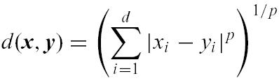

Introduction to L^{p} Norm
Of particular interest are geometric instances of the TSP, in which cities correspond to points in R^{d} for some d ≥ 1, and distances are computed according to some geometric norm. Perhaps the most popular norms are the Rectilinear, Euclidean, and Sup norms. These are examples of what is known as an “L^{p} norm” for p = 1, 2, and ∞. In general, the distance between two points x = (x₁, x₂, . . . , x_{d}) and y = (y₁, y₂, . . . , y_{d}) under the L^{p} norm, p ≥ 1, is
with the natural asymptotic interpretation that distance under the L∞ norm is

Slide 8
Polyhedral Norm
Polyhedral norms includes the Rectilinear and Sup norms, but can only approximate the Euclidean and other L^{p} norms.
Each polyhedral norm is determined by a unit ball, which is a centrally symmetric polyhedron P with the origin at its center.
To determine d(x, y) under such a norm, first translate the space so that one of the points, say x, is at the origin. Then, determine the unique factor α by which one must rescale P (expanding if α > 1, shrinking if α < 1) so that the other point (y) is on the boundary of the polyhedron. We then have d(x, y) = α.

Slide 9
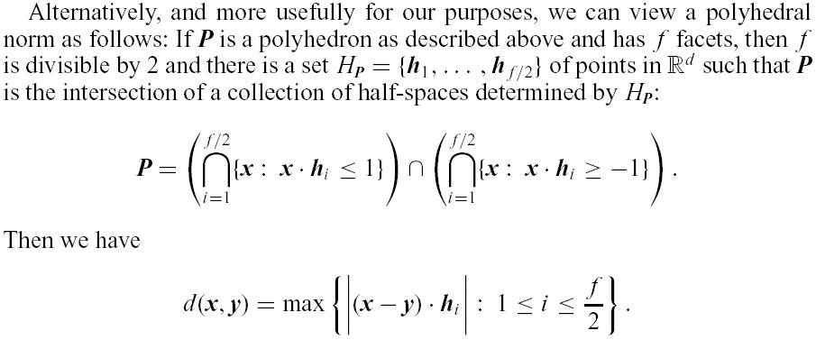
Formula for Distance in Polyhedral Norm
For the Rectilinear norm in the plane, we can take H_{P} = {(1, 1), (-1, 1)}
For the Sup norm in the plane we can take H_{P} = {(1, 0), (0, 1)}

Slide 10
An Example for Polyhedral Norm in Plane
Let x and y be two points where x = (0, 0) and y = (1, 1)
Let H_{P} = {(1, 1), (-1, 1)}, making this Polyhedral norm equal to Rectilinear norm
(1, 1)
(1, 1)
y
y
x
x
α= 1
α= 2
Here we have d(x, y) = 2, since y is on the boundary when α = 2
Note that we can use the formula mentioned last page to compute α efficiently.

Slide 11
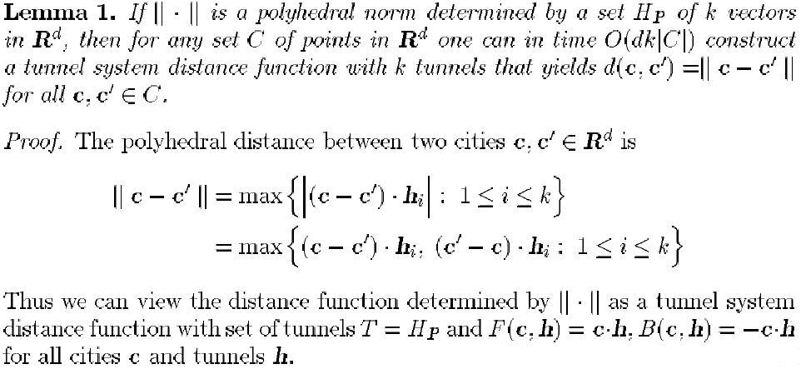
Polyhedral Norm to Tunneling TSP
Hence we can transfer a Polyhedral norm distance function which has f facets, into a tunneling system which has f/2 tunnels. In the previous example, we have f = 4 and k = 2 → An O(n²logn) algorithm for solving MAX TSP under Polyhedral norm

Slide 12
Conclusion
We have derived a polynomial time algorithm for the Maximum TSP when the cities are points in R^{d} for some fixed d and when the distances are measured according to some polyhedral norm. The complexity of the Maximum TSP with Euclidean distances and fixed d remains unsettled, however, even for d = 2. Although the Euclidean norm can be approximated arbitrarily closely by polyhedral norms, it is not itself a polyhedral norm.
Maximum TSP under Euclidean distances in R^{d} is an NP-hard
problem if d ≥ 3. (Journal of the ACM, Vol. 50, No. 5, September 2003, pp. 641–664.)
The complexity of the Maximum TSP in R² under the Euclidean metric remains an open question.

